Slide 2
THE IBEROAMERICAN FORO:
ACTIVITIES IN THE AREA OF NUCLEAR SAFETY
PREEV PROJECT: REGULATORY PRACTICES ON AGEING AND LIFE EXTENSION
IAEA CONSULTANTS MEETING
VIENNA, 11-13 APRIL 2012
D. ENCINAS (CSN, SPAIN)

Slide 3
THE IBEROAMERICAN FORO:
ACTIVITIES IN THE AREA OF NUCLEAR SAFETY
Iberoamerican Foro of Radiological and Nuclear Regulatory Bodies (FORO) is an association of 8 RBs in the Iberoamerican region
Founded in 1997 “to promote nuclear & radiological safety to the most high level in the region”
IAEA is the scientific reference organism of FORO and participate in all the technical activities of the association
After 15 years, FORO is considered as a consolidated association with an important volume of technical activities

Slide 4
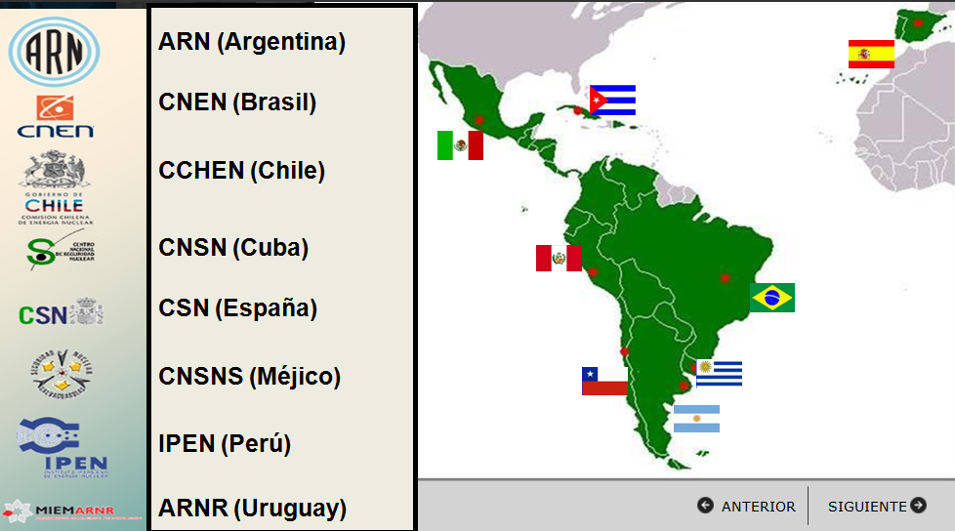
THE IBEROAMERICAN FORO:
ACTIVITIES IN THE AREA OF NUCLEAR SAFETY
Countries Members of FORO

Slide 5
THE IBEROAMERICAN FORO:
ACTIVITIES IN THE AREA OF NUCLEAR SAFETY
Mision of FORO:
  “to promote the safety in all the practices …
  “to promote the exchange of information and experience …
  “to share knowledgement and practical experience …
  “to establish relations with institutions of interest at national, regional and international level …

Slide 6
THE IBEROAMERICAN FORO:
ACTIVITIES IN THE AREA OF NUCLEAR SAFETY
Basis of activity of FORO:
  exchange of knowledges and experiences
  development of technical programs: technical areas / projects / workshops / other technical activities
  development and explotation of knowledgement networks

Slide 7
THE IBEROAMERICAN FORO:
ACTIVITIES IN THE AREA OF NUCLEAR SAFETY
Some important projects of FORO:
  development of PSA-based methodology to risks management in radiotherapy (LINAC treatments)
  self-assessment of regulatory programs of radiological protection in medical exposures
  PREEV
  “Iberoamerican stress tests”

Slide 8
THE IBEROAMERICAN FORO:
ACTIVITIES IN THE AREA OF NUCLEAR SAFETY
the area of Nuclear Safety of FORO:
  until 2007, most technical activities of FORO was concentrated in Radiological Protection ➔ not significant projects in Nuclear Safety
  main projects:
    workshop on systematic oversight of NPPs (2007)
    project PREEV (2009 – 2011)
    project “Iberoamerican stress tests” (2011 – 2012)
    project on development of RBs competences in Nuclear Safety (2012 – 2014)

